Slide 1

Netflix Data Analysis With Python
Presenters:
Miss. Tahseen Begum_2010030168
Miss. Keerthana Pulugam_2010030445
Miss. Pravallika_201003004
Miss. Sowgna_2010030344
Guide: Chanda Raj Kumar Rao

Slide 2
Outline
Introduction
Problem Statement
Flowchart
Literature Survey
Git commits
Pre-processing code and techniques
Alpha Testing
Conclusion
References
Suggestions

Slide 3
Introduction
Netflix is one of the largest providers of online streaming services. It collects a huge amount of data because it has a very large subscriber base. In this article, I’m going to introduce you to a data science project on Netflix data analysis with Python.
We can analyze a lot of data and models from Netflix because this platform has consistently focused on changing business needs by shifting its business model from on-demand DVD movie rental and now focusing a lot about the production of their original shows.

Slide 4
Problem Statement
I’ll take a look at some very important models of Netflix data to understand what’s best for their business. Some of the most important tasks that we can analyze from Netflix data are:
Understand what content is available
Understand the similarities between the content
Understand the network between actors and directors
What exactly Netflix is focusing on
Sentiment analysis of content available on Netflix.

Slide 5
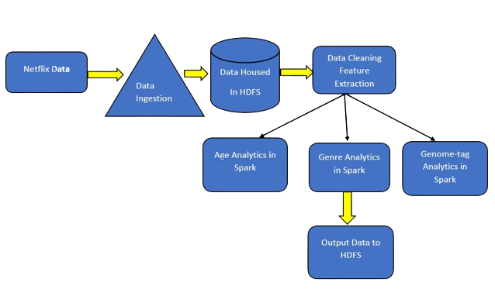
Flowchart

Slide 6
Literature Survey
Author | Title | Publishing | Dataset & Techniques | Pros
Rajeswari Nakka Dr.G.V.S.N.R.V.Prasadand R.Kiran Kumar | Offering Recommendations on Netflix dataset by Associations among Users as Trust Metric | 2021 | By this model several batches of data points are sampled among total dataset points. The results are well analysed over error rate where the proposed technique tends to have the reduced error value compared to existing Collaborative Filtering technique. In future the work can be extended on larger data points and address issues like memory issues, and utilize optimized matrix factorization technique to move a step further. | The model is evaluated using an evaluation metric Mean Squared Error (MSE) value. The performance of the proposed algorithm on the Netflix dataset was compared with existing algorithm
Vadloori, Karthik Babu, and Shriya Madhavi Sanghishetty. | Exploratory and Sentiment Analysis of Netflix Data | 2021 | An Open-Source Data Set obtained from Kaggle – that was wrangled and exercised to derive maximum insights using EDA – Exploratory Data Analysis and Sentiment Analysis after the amalgamation of two additional sets – Geographical Latitudes & Longitudes and Netflix Title Critics/Reviews Data Set. The project is made using different utility analytical tools present in Python Library of versatile packages | Introduces systematic and insightful usage of methods for Exploratory Data Analysis & Sentiment Analysis by utilizing various packages concerned.

Slide 7
Literature Survey
Author | Title | Publishing | Dataset & Techniques | Pros
Eva-Patricia Fernandez-Manzano, Elena Neira, Judith Clares-Gavilan | Data management in the audio visual industry: Netflix as a case study | July-August 2020 | Big data has become an enormous asset for on-demand content distribution services, helping information supply and decision-making, regarding both the content of the database and subscribers to the database. In this article, we describe and define big data and data management in a media company devoted to on-demand audio visual content distribution: Netflix. | The model is evaluated using an evaluation metric Mean Squared Error (MSE) value. The performance of the proposed algorithm on the Netflix dataset

Slide 8
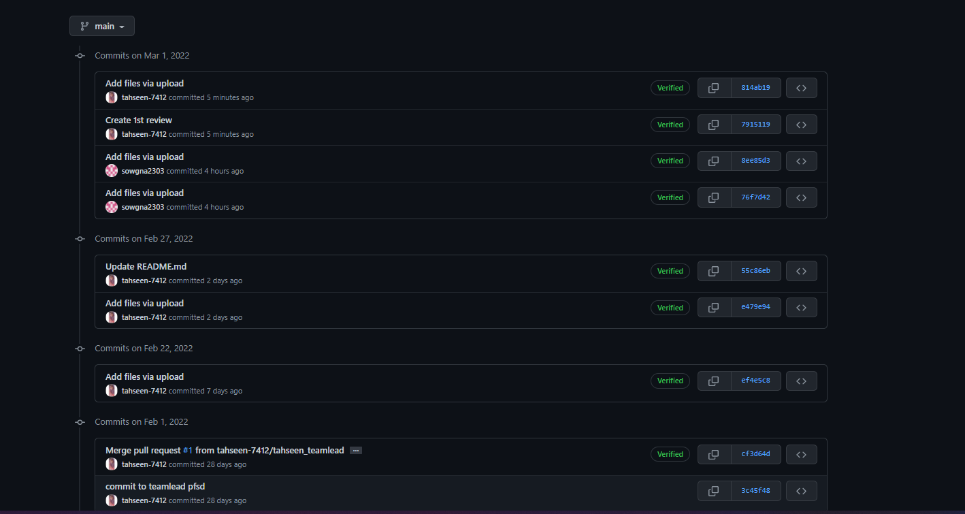
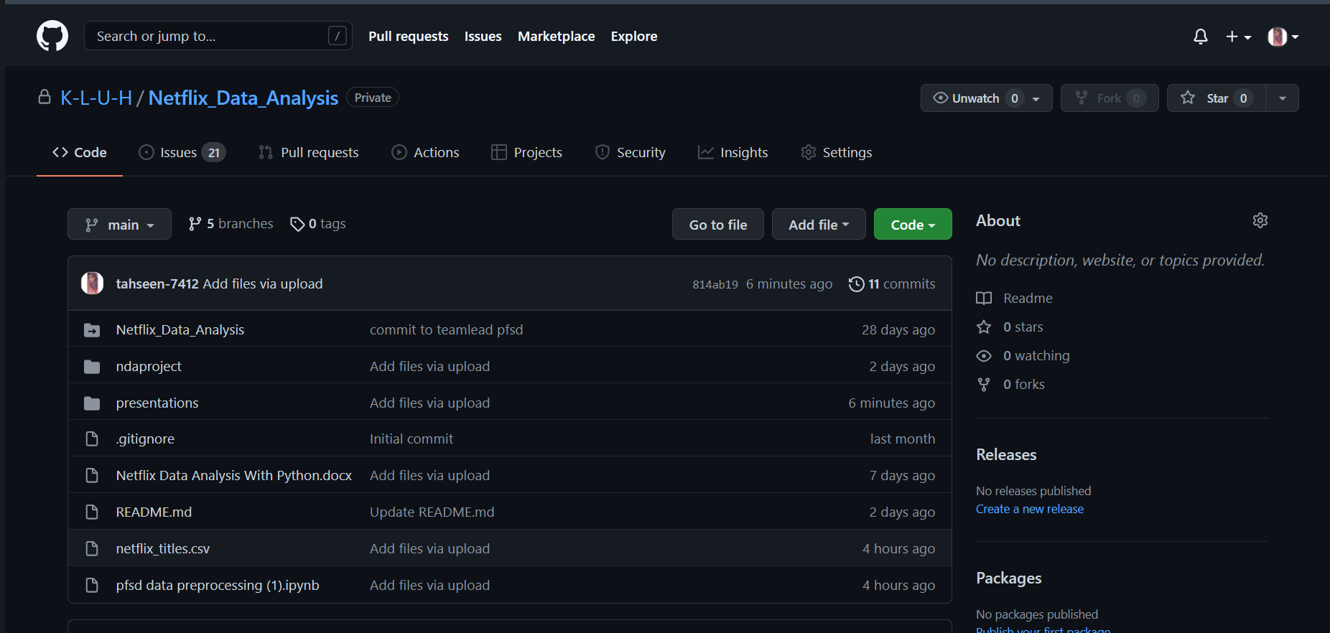
Git commits (Interval 11 commits after 1st review)

Slide 9
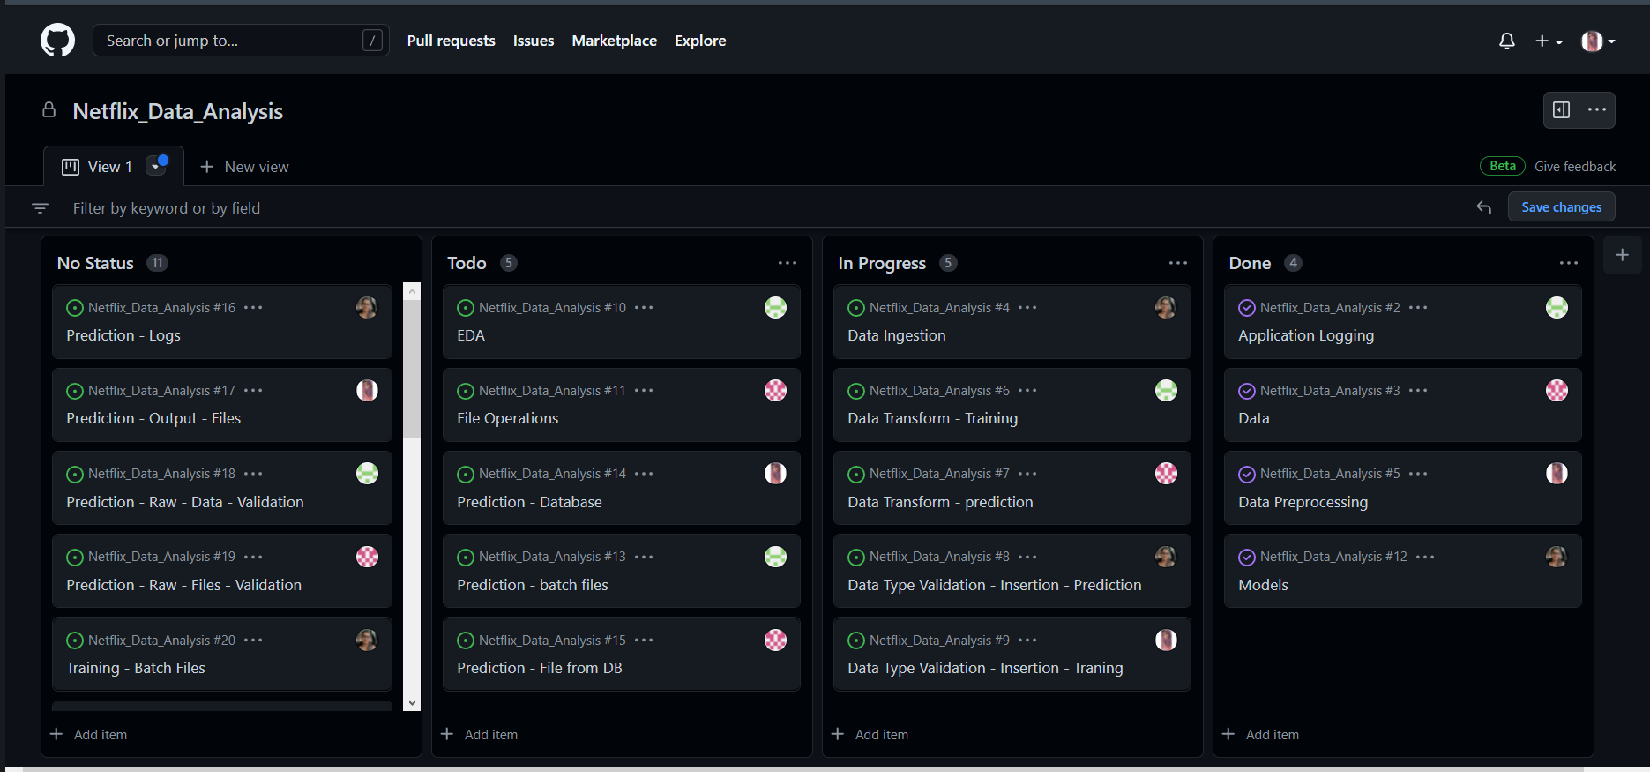
Work In Progress

Slide 10
Pre-processing code and techniques
Step-1:
!pip install matplotlib
Step-2:
#importing the dataset
import numpy as np # linear algebra
import pandas as pd # data processing, CSV file I/O (e.g. pd.read_csv)
import matplotlib.pyplot as plt
Step-3:
#to import csv file
netflix_data = pd.read_csv(r"C:\Users\Sowgn\OneDrive\Desktop\pfsd\netflix_titles.csv")
Step-4:
netflix_data
Step-5:
#head function
#to show top-5 records of the dataset
netflix_data.head()
Step-6:
#tail function
#to show bottom-5 records of dataset
netflix_data.tail()
Step-7:
#shape
#to show no of rows and colums
netflix_data.shape
Step-8:
#size
#to show no of total values(elements) in the dataset
netflix_data.size
Step-9:
netflix_data.columns
Step-10:
netflix_data.dtypes

Slide 11
Step-11:
netflix_data.info()
Step-12:
netflix_data.value_counts()
Step-13:
netflix_data.nunique()
Step-14:
netflix_data[netflix_data.duplicated()]
Step-15:
netflix_data.drop_duplicates()
Step-16:
netflix_data.isnull()
Step-17:
netflix_data.isnull().sum()
Step-18:
!pip install seaborn
Step-19:
import seaborn as sns
Step-20:
sns.heatmap(netflix_data.isnull())
Step-21:
netflix_data[netflix_data['title'].isin(['Blood & Water’])]
Step-22:
netflix_data['Date_N']=pd.to_datetime(netflix_data['date_added’])
Step-23:
netflix_data.head()
Step-24:
netflix_data['Date_N'].dt.year.value_counts()
Step-25:
netflix_data['Date_N'].dt.year.value_counts().plot(kind='bar’)
Step-26:
netflix_data.groupby('type').type.count()
Step-27:
sns.countplot(netflix_data['type’])
Step-28:
netflix_data['year']=netflix_data['Date_N'].dt.year
netflix_data.head(2)
Step-29:
netflix_data[(netflix_data['type']=='Movie')&(netflix_data['year']==2022)]

Slide 12
Alpha Testing
<!DOCTYPE html>
<html>
<head>
<meta name="viewport" content="with=device-width, initial-scale=1.0">
<title>Netflix Data Analysis</title>
<link rel ="stylesheet" href="style.css">
<link rel="preconnect" href="https://fonts.googleapis.com">
<link rel="preconnect" href="https://fonts.gstatic.com" crossorigin>
<link href="https://fonts.googleapis.com/css2?family=Poppins:wght@100;200;300;400;600;700&display=swap" rel="stylesheet">
<link rel="stylesheet" href="https://stackpath.bootstrapcdn.com/font-awesome/4.7.0/css/font-awesome.min.css">
</head>

Slide 13
<body>
<section class="header">
<nav>
<a href="index.html"><img src="images/logo.jpg"></a>
<div class="nav-links" id="navLinks">
<i class="fa fa-times-circle" onclick="hideMenu()"></i>
<ul>
<li><a href="index.html">HOME</a></li>
<li><a href="about.html">ABOUT</a></li>
<li><a href="movie.html">MOIVES</a></li>
<li><a href="data_analysis.html">DATA ANALYSIS</a></li>
<li><a href="contact.html">CONTACT</a></li>
</ul>
</div>
<i class="fa fa-bars" onclick="showMenu()"></i>
</nav>
<div class="text-box">
<h1>Unlimited movies, TV shows and more.</h1>
<p>Enjoy on your TV.
Watch on smart TVs, PlayStation, Xbox, Chromecast,<br>Apple TV, Blu-ray players and
more.</p>
<a href="" class="hero-btn">Visit Us to know More about it...</a>
</div>
</section>

Slide 14
<!---- Moives ---->
<section class="moives">
<h1>Enjoy on your TV.</h1>
<p> Watch on smart TVs, PlayStation, Xbox, Chromecast, Apple TV, Blu-ray players
and more.</p>
<div class="row">
<div class="moive-col">
<h3>English</h3>
<p>Red Notice · Back to the Outback · Midway · Sonic the Hedgehog · Spenser Confidential · Minions · Jumanji: Welcome to the Jungle </p>
</div>
<div class="moive-col">
<h3>Hindi</h3>
<p>Red Notice · Back to the Outback · Midway · Sonic the Hedgehog · Spenser Confidential · Minions · Jumanji: Welcome to the Jungle </p>
</div>
<div class="moive-col">
<h3>Telugu</h3>
<p>Red Notice · Back to the Outback · Midway · Sonic the Hedgehog · Spenser Confidential · Minions · Jumanji: Welcome to the Jungle </p>
</div>
<div class="moive-col">
<h3>ALL</h3>
<p>Red Notice · Back to the Outback · Midway · Sonic the Hedgehog · Spenser Confidential · Minions · Jumanji: Welcome to the Jungle </p>
</div>
</div>
</section>
<!----about--->
<section class="about">
<h1>Global Networks</h1>
<p> Watch on smart TVs, PlayStation, Xbox, Chromecast, Apple TV, Blu-ray players
and more.</p>
<div class="row">
<div class="about-col">
<img src="images/moive.jpg" >
<div class="layer">
<h3>BIGBOSS</h3>
</div>
</div>
<div class="about-col">
<img src="images/Bheemla.jpg" >
<div class="layer">
<h3>BHEEMLA NAYAK</h3>
</div>

Slide 15
</div>
<div class="about-col">
<img src="images/radheshyam.jpg" >
<div class="layer">
<h3>RADHE SHYAM</h3>
</div>
</div>
<div class="about-col">
<img src="images/rrr.jpg" >
<div class="layer">
<h3>RRR</h3>
</div>
</div>
</div>
</section>
<!---------- data ana ---->
<section class="data">
<h1>Data Analysis</h1>
<p>here we can see the percentage...</p>
<div class="row">
<div class="data-col">
<img src="images/netflix.png">
<h3>Data Neflix</h3>
<p>hindi movies</p>
</div>
<div class="data-col">
<img src="images/netflix.png">
<h3>Data Neflix</h3>
<p>telugu movies</p>
</div>
<div class="data-col">
<img src="images/netflix.png">
<h3>Data Neflix</h3>
<p>english movies</p>
</div>
</div>
</section>
<!---------- call to action-------->
<section class="cta">
<h1>Team Contact</h1>
<a href="" class="hero-btn">CONTACT US</a>
</section>
<!----- footer ---------->
<section class="footer">
<h4>About Us</h4>
<p>Students from KL University</p>
<div class="icons">
<i class="fa fa-facebook"></i>
<i class="fa fa-twitter"></i>
<i class="fa fa-instagram"></i>
<i class="fa fa-linkedin"></i>
<i class="fa fa-github"></i>
</section>
<!-----JavaScript for Toggle Menu----->
<script>
var navLinks = document.getElementById("navLinks");
function showMenu(){
navLinks.style.right = "0";
}
function hideMenu(){
navLinks.style.right = "-200px";
}
</script>
</body>
</html>

Slide 16
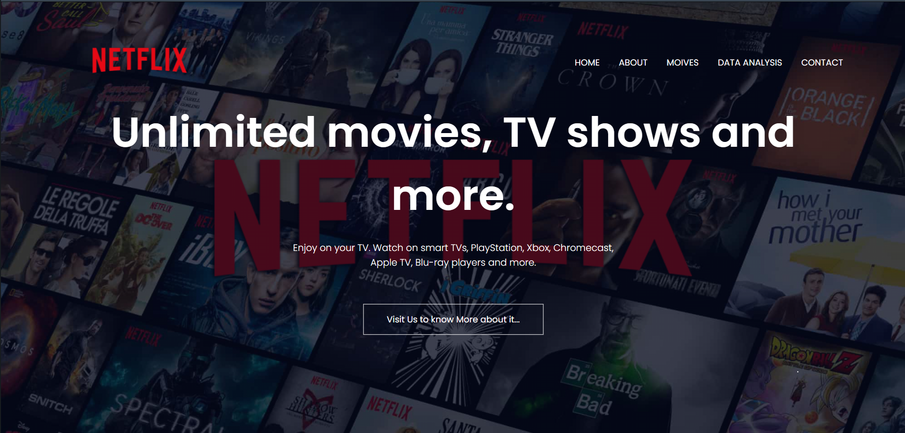

Slide 17
Division of work among the group members
N. Sowgna-Pre-processing code and techniques
Tahseen Begum-Alpha Testing
E. Pravallika – Flowchart, Doc
Keerthana -PPT

Slide 18
Conclusion
We have completed the front-end for this project.
Next we will work on the back-end.

Slide 19
References
https://www.researchgate.net/publication/345710976_Offering_Recommendations_on_Netflix_dataset_by_Associations_among_Users_as_Trust_Metric
https://www.researchgate.net/publication/354719521_Exploratory_and_Sentiment_Analysis_of_Netflix_Data
https://www.researchgate.net/publication/305741976_Data_management_in_audiovisual_business_Netflix_as_a_case_study
https://www.youtube.com/watch?v=b7Kd0fLwgO4
https://www.kaggle.com/shivamb/netflix-shows

Slide 20
Suggestions

